Slide 1
Creating a Valid XML Document

Slide 2
Creating a Valid Document
You validate documents to make certain necessary elements are never omitted.
For example, each customer order should include a customer name, address, and phone number.

Slide 3
Creating a Valid Document
Some elements and attributes may be optional, for example an e-mail address.
An XML document can be validated using either DTDs (Document Type Definitions) or schemas.

Slide 4
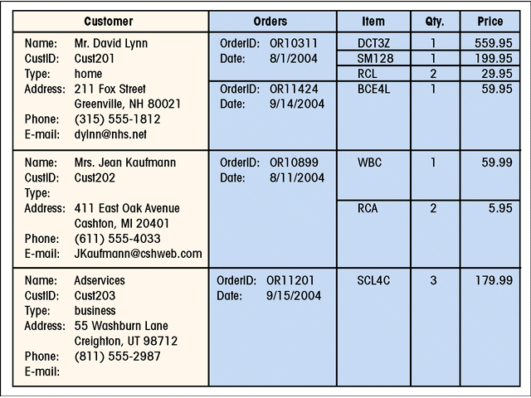
Customer Information Collected by Kristen
This figure shows customer information collected by Kristen

Slide 5
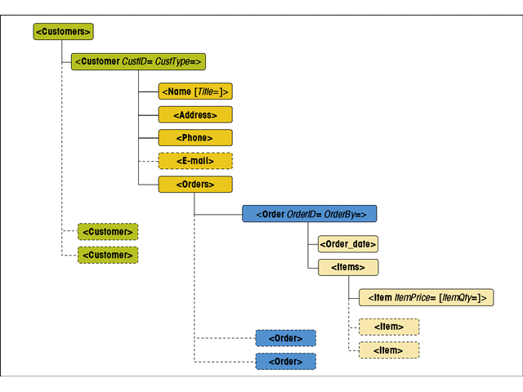
The Structure of Kristen’s Document
This figure shows the overall structure of Kristen’s document

Slide 6
Declaring a DTD
A DTD can be used to:
  Ensure all required elements are present in the document
  Prevent undefined elements from being used
  Enforce a specific data structure
  Specify the use of attributes and define their possible values
  Define default values for attributes
  Describe how the parser should access non-XML or non-textual content

Slide 7
Declaring a DTD
There can only be one DTD per XML document.
A document type definition is a collection of rules or declarations that define the content and structure of the document.
A document type declaration attaches those rules to the document’s content.

Slide 8
Declaring a DTD
You create a DTD by first entering a document type declaration into your XML document.
DTD in this tutorial will refer to document type definition and not the declaration.
While there can only be one DTD, it can be divided into two parts: an internal subset and an external subset.

Slide 9
Declaring a DTD
An internal subset is declarations placed in the same file as the document content.
An external subset is located in a separate file.

Slide 10
Declaring a DTD
The DOCTYPE declaration for an internal subset is:
  <!DOCTYPE root
  [
  declarations
  ]>
Where root is the name of the document’s root element, and declarations are the statements that comprise the DTD.

Slide 11
Declaring a DTD
The DOCTYPE declaration for external subsets can take two forms: one that uses a SYSTEM location and one that uses a PUBLIC location.
The syntax is:
  <!DOCTYPE root SYSTEM “URL”> or
  <!DOCTYPE root PUBLIC “identifier” “URL”>

Slide 12
Declaring a DTD
Here, root is the document’s root element, identifier is a text string that tells an application how to locate the external subset, and URL is the location and filename of the external subset.
Use the PUBLIC location form when the DTD needs to be limited to an internal system or when the XML document is part of an old SGML application.

Slide 13
Declaring a DTD
The SYSTEM location form specifies the name and location of the external subset through the “URL” value.
Unless your application requires a public identifier, you should use the SYSTEM location form.

Slide 14
Declaring a DTD
A DOCTYPE declaration can indicate both an external and an internal subset. The syntax is:
<!DOCTYPE root SYSTEM “URL”
[
declarations
]>
or
<!DOCTYPE root PUBLIC “identifier” “URL”
[
declarations
]>

Slide 15
Declaring a DTD
If you place the DTD within the document, it is easier to compare the DTD to the document’s content. However, the real power of XML comes from an external DTD that can be shared among many documents written by different authors.

Slide 16
Declaring a DTD
If a document contains both an internal and an external subset, the internal subset takes precedence over the external subset if there is a conflict between the two.
This way, the external subset would define basic rules for all the documents, and the internal subset would define those rules specific to each document.

Slide 17
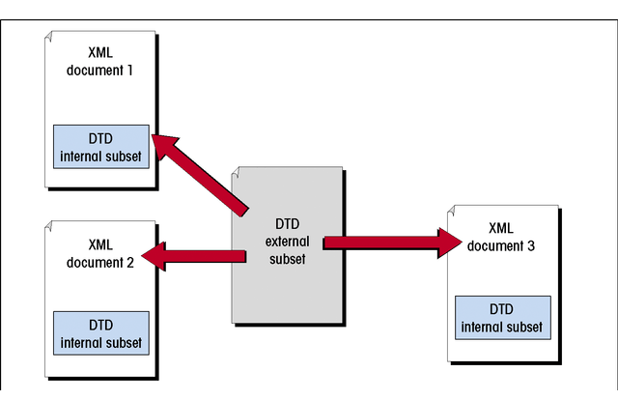
Combining an External and Internal DTD Subset
This figure shows how to combine an external and an internal DTD subset

Slide 18
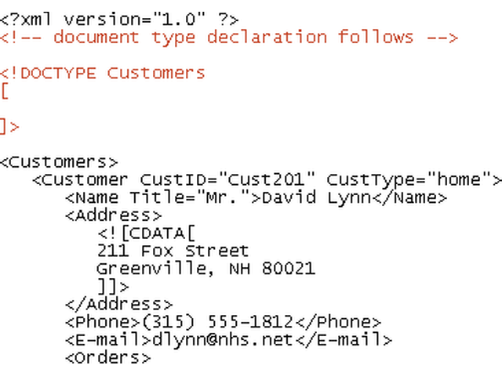
Writing the Document Type Declaration
This figure shows how to insert an internal DTD subset
document comment
the root element
DTD statements are inserted here
the root element of the document must match the root element listed in the DOCTYPE declaration

Slide 19
Declaring Document Elements
Every element used in the document must be declared in the DTD for the document to be valid.
An element type declaration specifies the name of the element and indicates what kind of content the element can contain.

Slide 20
Declaring Document Elements
The element declaration syntax is:
  <!ELEMENT element content-model>
Where element is the element name and content-model specifies what type of content the element contains.

Slide 21
Declaring Document Elements
The element name is case sensitive.
DTDs define five different types of element content:
  Any elements. No restrictions on the element’s content.
  Empty elements. The element cannot store any content.

Slide 22
Declaring Document Elements
  Character data. The element can only contain a text string.
  Elements. The element can only contain child elements.
  Mixed. The element contains both a text string and child elements.

Slide 23
Types of Element Content
ANY content: The declared element can store any type of content. The syntax is:
  <!ELEMENT element ANY>
EMPTY content: This is reserved for elements that store no content. The syntax is:
  <!ELEMENT IMG EMPTY>

Slide 24
Types of Element Content
CHARACTER content: These elements can only contain text strings. The syntax is:
  <!ELEMENT element (#PCDATA)>
The keyword #PCDATA stands for “parsed-character data” and is any well-formed text string.

Slide 25
Types of Element Content
ELEMENT content.: The syntax for declaring that elements contain only child elements is:
  <!ELEMENT element (child elements)>
Where child elements is a list of child elements.

Slide 26
Types of Element Content
The declaration <!ELEMENT Customer (Phone)> indicates the Customer element can only have one child, named Phone. You cannot repeat the same child element more than once with this declaration.

Slide 27
Element Sequences and Choices
A sequence is a list f elements that follow a defined order. The syntax is:
  <!ELEMENT element (child1, child2, …)>
The order of the child elements must match the order defined in the element declaration. A sequence can be applied to the same child element.

Slide 28
Element Sequences and Choices
Thus,
  <!ELEMENT Customer (Phone, Phone, Phone)>
indicates the Customer element should contain three child elements named Phone.

Slide 29
Element Sequences and Choices
Choice is the other way to list child elements and presents a set of possible child elements. The syntax is:
  <!ELEMENT element (child1 | child2 | …)>
where child1, child2, etc. are the possible child elements of the parent element.

Slide 30
Element Sequences and Choices
For example,
<!ELEMENT Customer (Name | Company)>
This allows the Customer element to contain either the Name element or the Company element. However, you cannot have both the Customer and the Name child elements since the choice model allows only one of the child elements.

Slide 31
Modifying Symbols
Modifying symbols are symbols appended to the content model to indicate the number of occurrences of each element. There are three modifying symbols:
  a question mark (?), allow zero or one of the item.
  a plus sign (+), allow one or more of the item.
  an asterisk (*), allow zero or more of the item.

Slide 32
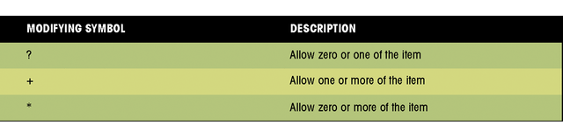
Modifying Symbols
Modifying Symbols

Slide 33
Modifying Symbols
For example, <!ELEMENT Customer (Name+)> would allow the document to contain one or more Name elements to be placed within the Customer element.
Modifying symbols can be applied within sequences or choices. They can also modify entire element sequences or choices by placing the character immediately following the closing parenthesis of the sequence or choice.

Slide 34
Mixed Content
Mixed content elements contain both character data and child elements. The syntax is:
  <!ELEMENT element (#PCDATA) | child1 | child2 | …)*>
This form applies the * modifying symbol to a choice of character data or elements. Therefore, the parent element can contain character data or any number of the specified child elements, or it can contain no content at all.

Slide 35
Mixed Content
Because you cannot constrain the order in which the child elements appear or control the number of occurrences for each element, it is better not to work with mixed content if you want a tightly structured document.

Slide 36
Declaring Element Attributes
For a document to be valid, all the attributes associated with elements must also be declared. To enforce attribution properties, you must add an attribute-list declaration to the document’s DTD.

Slide 37
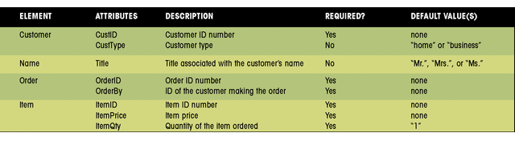
Element Attributes in Kristen’s Document
This figure shows element attributes in Kristen's document

Slide 38
Declaring Element Attributes
The attribute-list declaration :
  Lists the names of all attributes associated with a specific element
  Specifies the data type of the attribute
  Indicates whether the attribute is required or optional
  Provides a default value for the attribute, if necessary

Slide 39
Declaring Element Attributes
The syntax to declare a list of attributes is:
<!ATTLIST element attribute1 type1 default1
attribute2 type2 default2
attribute3 type3 default3…>
Where element is the name of the element associated with the attributes, attribute is the name of an attribute, type is the attribute’s data type, and default indicates whether the attribute is required or implied, and whether it has a fixed or default value.

Slide 40
Declaring Element Attributes
Attribute-list declaration can be placed anywhere within the document type declaration, although it is easier if they are located adjacent to the declaration for the element with which they are associated.

Slide 41
Working with Attribute Types
While all attribute types are text strings, you can control the type of text used with the attribute. There are three general categories of attribute values:
  string
  enumerated
  Tokenized
String types are the simplest form and can contain any character except those reserved by XML.
Enumerated types are attributes that are limited to a set of possible values.

Slide 42
Working with Attribute Types
The general for of an enumerated type is:
  attribute (value1 | value2 | value3 | …)
For example, the following declaration:
  Customer CustType (home | business )>
restricts CustType to either “home” or “business”

Slide 43
Working with Attribute Types
Another type of enumerated attribute is notation. It associates the value of the attribute with a <!NOTATION> declaration located elsewhere in the DTD. The notation provides information to the XML parser about how to handle non-XML data.
Tokenized types are text strings that follow certain rules for the format and content. The syntax is:
attribute token

Slide 44
Working with Attribute Types
There are seven tokenized types. For example, the ID token is used with attributes that require unique values. For example, if a customer ID needs to be unique, you may use the ID token:
  Customer CustID ID
This ensures each customer will have a unique ID.

Slide 45
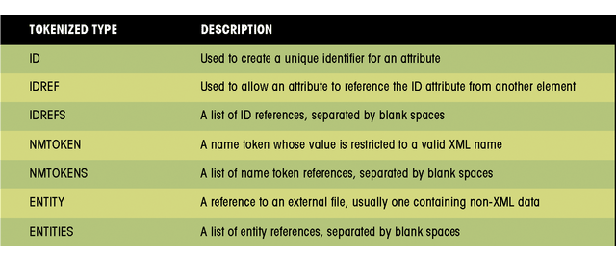
Attribute Tokens
This figure shows the seven attribute tokens

Slide 46
Attribute Defaults
The final part of an attribute declaration is the attribute default. There are four possible defaults:
  #REQUIRED: the attribute must appear with every occurrence of the element.
  #IMPLIED: The attribute is optional.
  An optional default value: A validated XML parser will supply the default value if one is not specified.
  #FIXED: The attribute is optional but if one is specified, it must match the default.

Slide 47
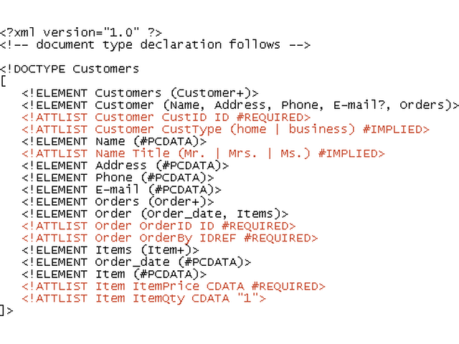
Inserting Attribute-List Declarations
This figure the revised contents of the Orders.xml file
attribute declaration

Slide 48
Working with Entities
Entities are storage units for a document’s content. The most fundamental entity is the XML document itself and is known as the document entity. Entities can also refer to:
  a text string
  a DTD
  an element or attribute declaration
  an external file containing character or binary data

Slide 49
Working with Entities
Entities can be declared in a DTD. How to declare an entity depends on how it is classified. There are three factors involved in classifying entities:
  The content of the entity
  How the entity is constructed
  Where the definition of the entity is located.

Slide 50
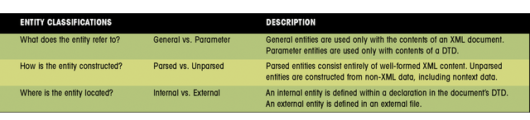
Working with Entities
This figure shows the three entity classifications

Slide 51
General Parsed Entities
General entities are declared in the DTD of a document. The syntax is:
  <!ENTITY entity “value”>
Where entity is the name assigned to the entity and value is the general entity’s value.
For example, an entity named “Pixal” can be created to store a company's official name:
  <!ENTITY Pixal (“Pixal Digital Products”>

Slide 52
General Parsed Entities
After an entity is declared, it can be referenced anywhere within the document.
  <Title>This is the home page of &Pixal;.</Title>
This is interpreted as
  <Title>This is the home page of Pixal Digital Products</Title>

Slide 53
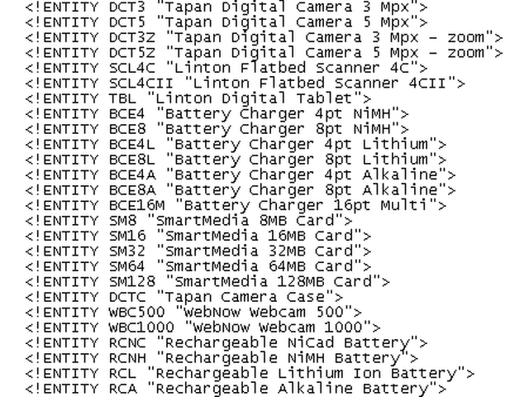
Entities in the ITEMS.DTD File
This figure shows the entities in the ITEMS.DTD file
entity name
entity value

Slide 54
General External Entities
General entities can refer to values located in external files. The syntax is:
  <!ENTITY entity SYSTEM “URL”>
For example, in the declaration:
  <!ENTITY headlines SYSTEM http://www.newsflash.com/stories.xml>
An entity named “headlines” gets its value from the document, stories.xml located at http://www.newsflash.com/stories.xml

Slide 55
Parameter Entities
Parameter entities are used to store the content of a DTD. For internal parameter entities, the syntax is:
  <!ENTITY % entity “value”>
where entity is the name of the parameter entity and value is a text string of the entity’s value.
For external parameter entities, the syntax is:
  <!ENTITY % entity SYSTEM “URL”>
where URL is the name assigned to the parameter entity.

Slide 56
Parameter Entities
Parameter entity references can only be placed where a declaration would normally occur, such as an internal or external DTD.
Parameter entities used with an internal DTD do not offer any time or effort savings. However, an external parameter entity can allow XML to use more than one DTD per document by combining declarations from multiple DTDs.

Slide 57
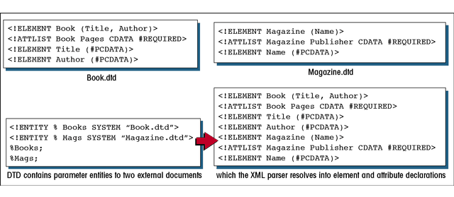
Using Parameter Entities to Combine Multiple DTDs
This figure shows how to combine multiple DTDs using parameter entities

Slide 58
Unparsed Entities
You need to create an unparsed entity in order to reference binary data such as images or video clips, or character data that is not well formed. The unparsed entity includes instructions for how the unparsed entity should be treated.
A notation is declared that identifies a resource to handle the unparsed data.

Slide 59
Unparsed Entities
For example, to create a notation named “audio” that points to an application Recorder.exe:
  <!NOTATION audio SYSTEM “recorder.exe”>
Once the notation has been declared, you then declare an unparsed entity that instructs the XML parser to associate the data to the notation.

Slide 60
Unparsed Entities
For example, to take unparsed data in an audio file and assign it to an unparsed entity named “Theme:”, use the following:
  <!ENTITY Theme SYSTEM “Overture.wav” NDATA audio>
Here, the notation is the audio notation that points to the Recorder.exe file. This declaration does not tell the Record.exe application to run the file but simply identifies for the XML parser what resource is able to handle the unparsed data.

